Slide 1
VIRTUAL MEMORY
GVHD: TRẦN NGỌC THỊNH
NHÓM TRÌNH BÀY: NHÓM 2

Slide 2
Content
Replacement policy
Segmentation
Protection

Slide 3
Content
Replacement policy
Segmentation
Protection

Slide 4
Replacement Policy
Paging mechanism
Page replacement algorithms
Translation lookaside buffer

Slide 5
Paging mechanism
Page fault:
When a program accesses a page that is mapped in the virtual address space, but not loaded in physical memory.
When paging happens:
When a page fault occurs and a free page cannot be used to satisfy the allocation.

Slide 6
Paging mechanism
Determine the location of the data in auxiliary storage.
Obtain an empty page frame in RAM (physical memory) to use as a container for the data.
Load the requested data into the available page frame.
Update the page table to show the new data.
Return control to the program, restart the instruction that caused the page fault.

Slide 7
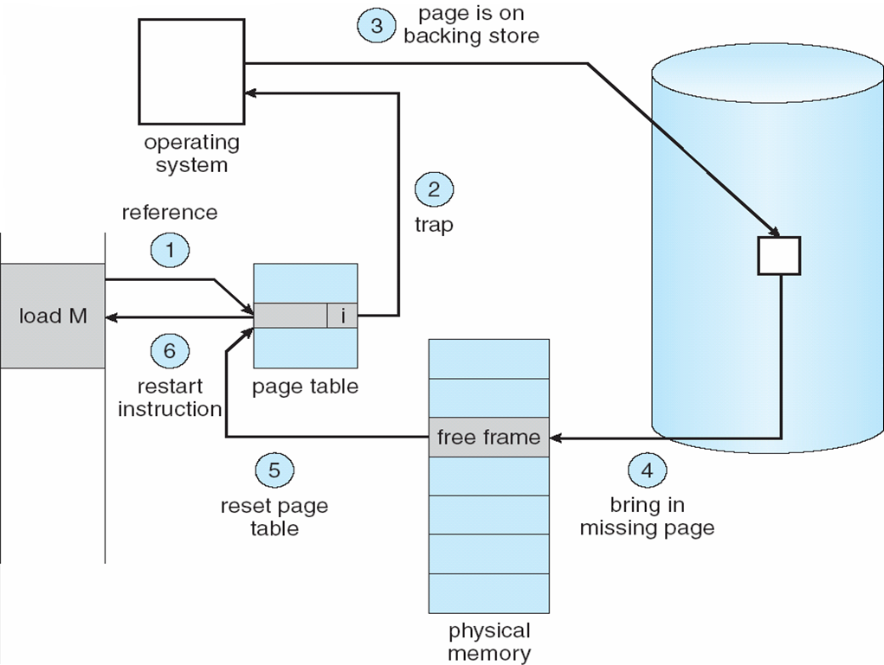
Paging mechanism

Slide 8
Page Replacement Algorithms
What is page replacement algorithm?
There is no free frame.
Decide which memory pages to page out (swap out, write to disk) when a page of memory needs to be allocated.
Need a page replacement algorithm to select a victim frame

Slide 9
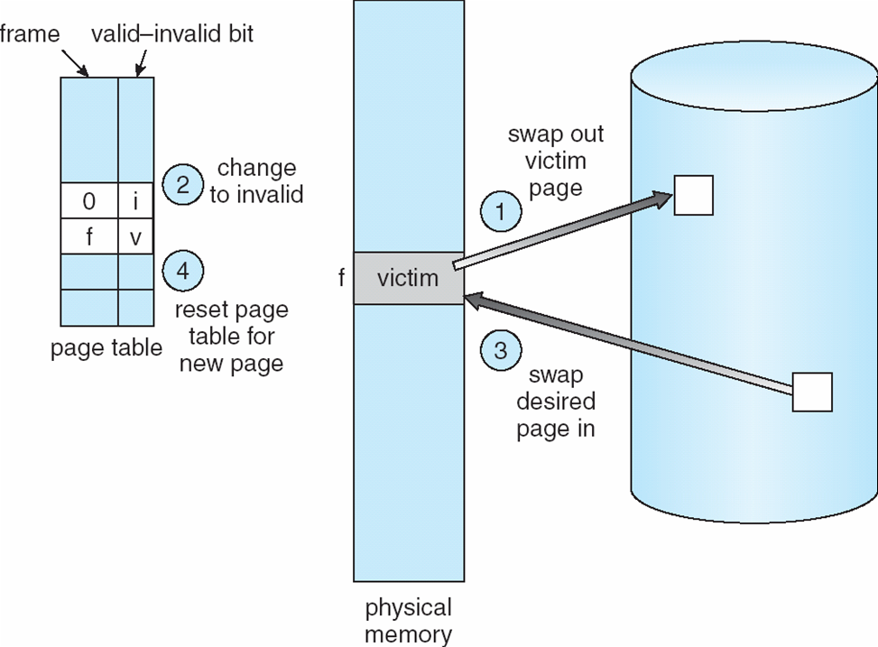
Page Replacement Algorithms

Slide 10
Page Replacement Algorithms
Algorithms
Optimal
FIFO (First In First Out)
Clock
FIFO with second chance
LRU (Least Recently Used)
NFU (Not Frequently Used)
Random

Slide 11
Page Replacement Algorithms
Optimal
Replace the page that won’t be used for the longest time in the future.
Optimal solution and can be used as an off-line analysis method
Problem:
No on-line implementation. Can’t know the future of a program
The optimal algorithm is unrealizable
However:
Simulation studies, Can compare others to “optimal” algorithm
Notes:
Cons: because it is impossible to compute reliably how long it will be before a page is going to be used
Pros: keeps track of all pages referenced by the program, and it uses those data to decide which pages to swap in and out on subsequent runs.

Slide 12
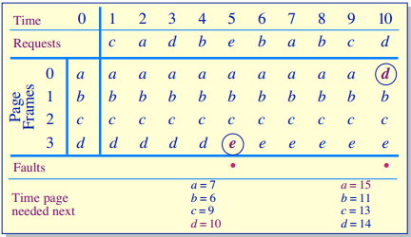
Page Replacement Algorithms
Optimal
e

Slide 13
Page Replacement Algorithms
FIFO (First In First Out)
Replace the page that has been in memory for the longest time
Maintain a linked list of all pages in memory
The page at the front of the list is oldest
Add new page to end of list
Low-overhead implementation
Disadvantage:
The oldest page may be needed again soon

Slide 14
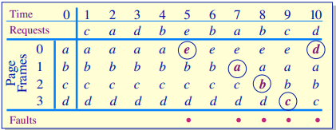
Page Replacement Algorithms
FIFO (First In First Out)

Slide 15
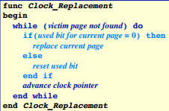
Page Replacement Algorithms
Clock
Maintain a circular list of pages resident in memory.
Hand points to the oldest page
Used bit
On a page fault

Slide 16
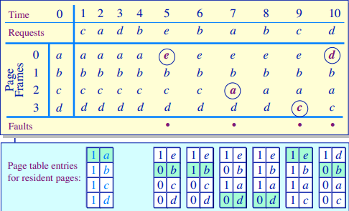
Page Replacement Algorithms
Clock

Slide 17
Page Replacement Algorithms
FIFO with second chance
Check the reference-bit of the oldest page
If it is 0, then replace it
If it is 1, clear the referent-bit, put it to the end of the list and continue searching
Pros: Simple to implement
Cons: The worst case may take a long time

Slide 18
Page Replacement Algorithms
LRU (Least Recently Used)
Replace page that hasn’t been used for the longest time
Order the pages by time of reference
Timestamp for each referenced page

Slide 19
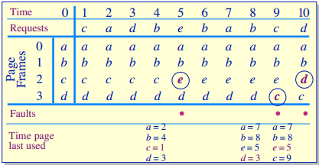
Page Replacement Algorithms
LRU (Least Recently Used)

Slide 20
Page Replacement Algorithms
NFU (Not Frequently Used)
Requires a counter, and every page has one counter of its own which is initially set to 0.
At each clock interval, all pages that have been referenced within that interval will have their counter incremented by 1.
The page with the lowest counter can be swapped out when necessary.

Slide 21
Page Replacement Algorithms
Random
Replaces a random page in memory

Slide 22
Translation Lookaside Buffer
What is TLB?
Every memory access logically takes one memory access to obtain the physical address and a second access to get the data.
A translation lookaside buffer (TLB) is a cache that memory management hardware uses to improve virtual address translation speed by reducing a second access to translate the data.

Slide 23
Translation Lookaside Buffer
How can it work? In the Opteron TLB organization
TLB uses fully associative placement, the translation begins (steps 1 and 2) by sending the virtual address to all marked tags, at the same time, the type of memory access is checked for a violation.
The matching tag sends the corresponding physical address through effectively a 40:1 multiplexor (step 3).
The page offset is then combined with the physical page frame to form a full physical address (step 4).

Slide 24
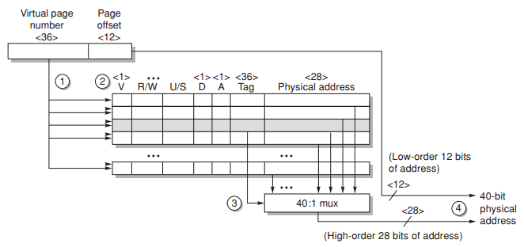
Translation Lookaside Buffer

Slide 25
Content
Replacement policy
Segmentation
Protection

Slide 26
Segmentation
A program includes segments. A segment is logical unit :
main program, procedure, function
local variables, global variables, common block, stack, symbol table, arrays,…
Pascal compiler
Global variables
Procedure call stack
Procedure/function code
Local variable
stack
procedure
symbol
table
function
sqrt
main program

Slide 27
Segmentation
Logical Address
(segment number, offset)
Segment table
(base, limit)
Segment-table base register (STBR)
Segment-table length register (STLR)

Slide 28
Sharing segment
editor
data 1
data 2
editor
 | limit | base
0 | 25286 | 43062
1 | 4425 | 68348
data 1
43062
segment 0
segment 1
segment table
process P₁
logical address space
process P₁
68348
72773
editor
 | limit | base
0 | 25286 | 43062
1 | 8850 | 90003
data 2
90003
segment 0
segment 1
98853
segment table
process P₂
physical memory

Slide 29
Segmentation with Paging
A segment is too large ???
=> Paging the segment
A process :
A segment table
A page table for each segment
Logical address
segment number
page number
offset

Slide 30
Content
Replacement policy
Segmentation
Protection

Slide 31
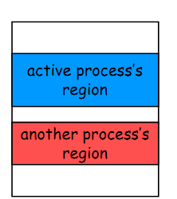
Memory Protection
Earliest machines did not have the concept of protection and address translation
no need - single process, single user
programs operated on physical addresses directly cannot support multitasking protection
Multitasking
give each process a non-overlapping, contiguous physical memory region
everything belonging to a process must fit in that region
how do you keep one process from reading or trashing another process’ data?

Slide 32
Memory Protection – what?
Memory Protection is a way to control memory access rights on a computer (wikipedia)
The main purpose is to prevent a process from accessing memory that has not been allocated to it

Slide 33
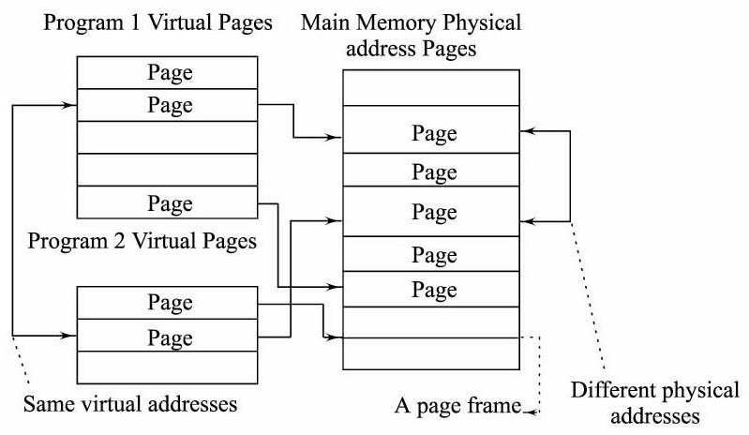
Memory Protection – VM system

Slide 34
Memory Protection – VM System
Each program
Own virtual address space
Physical address space shared between all of the programs running on the system
The address translation program map onto different physical page frames and different locations on the magnetic or other media

Slide 35
Memory Protection – VM system
VM as a tool to support multiprogramming
To allow programs to use more memory than is provided in the system’s main memory
Provide protection between programs and to allow automatic swapping of each program’s data between the main memory and disk on a context switch extremely valuable

Slide 36
Memory protection – VM system
Using context switching and changing the page table on switching from executing one program to executing another
Advantages:
Prevents programs from accessing each other’s data because any
virtual address that a program references will be translated into a physical address belonging to it
A program can create and use addresses in its own virtual address space without interference from other programs
Disadvantages:
needs to change the page table that it uses, and to invalidate any address translations in the TLB
the new program would use the old program’s virtual-physical address mapping, and be able to access the old program’s data

Slide 37
Memory protection – VM system
Disadvantages (cont):
Context switch increases the overhead
Time required to invalidate the TLB
Change the page table
New program will take a large number of TLB misses as it starts executing with an empty TLB

Slide 38
Memory Protection - paging
Protection on page virtual memory
Each page can be made to reside in any location of the physical memory, or be flagged as being protected.
Each process was allocated a page to run
By such design, it is impossible for an application to access a page that has not been explicitly allocated to it
When a process point to unallocated for that process will cause an page fault and OS will decide whether the rest process will be loaded and executed or not.

Slide 39
Virtual Memory Protection – Using Segmentation
A segment has a length and set of permissions associated with it
A process is only allowed to make a reference into a segment:
type of reference is allowed by the permissions
offset within the segment is within the range specified by the length of the segment
Segments may also have a flag indicating whether the segment is present in main memory or not
segment is accessed that is not present in main memory
An exception is raised
The operating system will read the segment into memory from secondary storage

Slide 40
Virtual Memory Protection – Using Segmentation
Logical address is a pair (segment number , offset)
Segment table: Including entries, each one describes one segment and contain
Limit: size of segment
Base: beginning address of segment in the memory
Segment-table base register (STBR): point to segment table
Segment-table length register (STLR): number of segments on one program

Slide 41
Virtual Memory Protection – Using Segmentation
1400
Procedure
Stack
Main
Symbol table
Function
Procedure
Segment 0
Stack
Segment 3
 | Limit | Base
s0 | 1000 | 1400
s1 | 400 | 6300
s2 | 400 | 4300
s3 | 1100 | 3200
s4 | 1000 | 4700
2400
3200
Symbol table
Segment 4
4300
4700
Function
Segment 1
Main
Segment 2
5700
6300
Segment table
Logical address space
Physical memory space

Slide 42
Virtual Memory Protection – Using Segmentation
Limit | Base
Segment table
S
CPU
s | d
Physical memory
<
+
trap; addressing error

Slide 43
MEMORY PROTECTION – COMBINE PAGE AND SEGMENTATION
Protection using combine page and segmentation
This the most common method to implement memory protection mechanism
This method will combine the power full of dynamic size of segmentation and the page virtual memory to load look up and load the data when page fault happen
Idea: paging segment so that the pages of segment will be loaded into discontinuous frames

Slide 44
MEMORY PROTECTION – COMBINE PAGE AND SEGMENTATION (CONT’D)
There’re many ways to combine, one simple is: segmentation with paging
Each process will be provided
Segment table
Multi page table: each segment has one page table
One logic address, including:
Segment number: index of one item in the segment table, the item contains base address of the page table of this segment table
Page number: Index of one item in the page table, the item contains frame index in physical memory
Offset: Spacing of the above frame memory

Slide 45
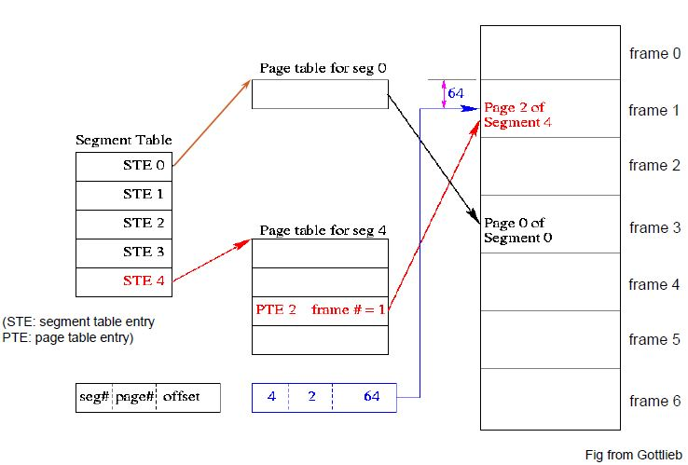
MEMORY PROTECTION – COMBINE PAGE AND SEGMENTATION (CONT’D)

Slide 46
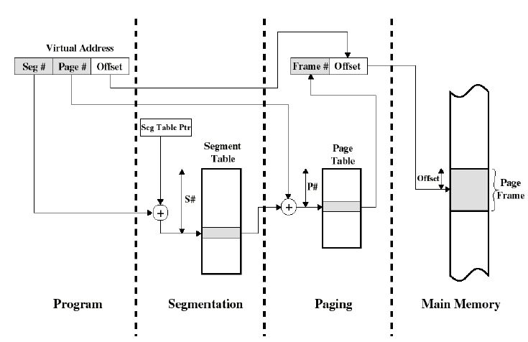
MEMORY PROTECTION – COMBINE PAGE AND SEGMENTATION (CONT’D)
Notes:
Figure suggests a structure to support combined paging/segmentation
.Associated with each process is a segment table and
a number of page tables, one per process segment. When a particular process is
running, a register holds the starting address of the segment table for that process.
Presented with a virtual address, the processor uses the segment number portion to
index into the process segment table to find the page table for that segment. Then
the page number portion of the virtual address is used to index the page table and
look up the corresponding frame number. This is combined with the offset portion
of the virtual address to produce the desired real address.

Slide 47
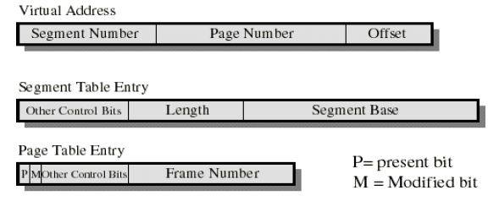
MEMORY PROTECTION – COMBINE PAGE AND SEGMENTATION (CONT’D)
Segment base: physical address of the page table of segment
Present (valid) bit and modified bit: Just exist in page table
Information about shared memory are normally in segment table
Notes:
Figure suggests the segment table entry and page table entry formats. As
before, the segment table entry contains the length of the segment. It also contains
a base field, which now refers to a page table. The present and modified bits are not
needed because these matters are handled at the page level. Other control bits may
be used, for purposes of sharing and protection. The page table entry is essentially
the same as is used in a pure paging system. Each page number is mapped into a corresponding
frame number if the page is present in main memory. The modified bit
indicates whether this page needs to be written back out when the frame is allocated
to another page. There may be other control bits dealing with protection or other
aspects of memory management.

